Slide 1
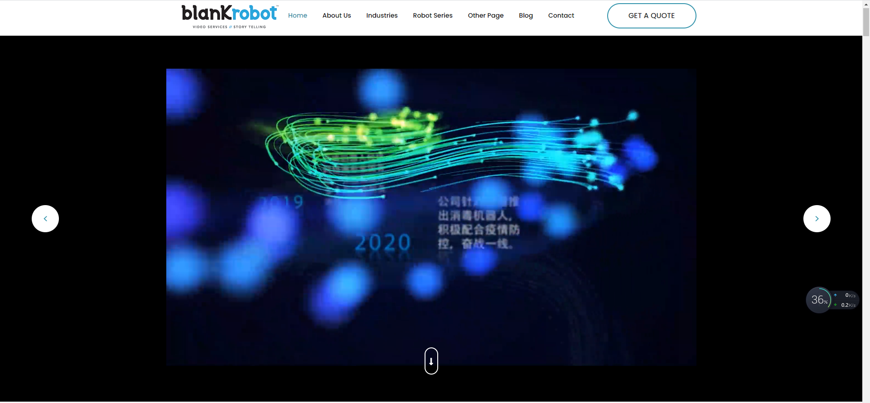
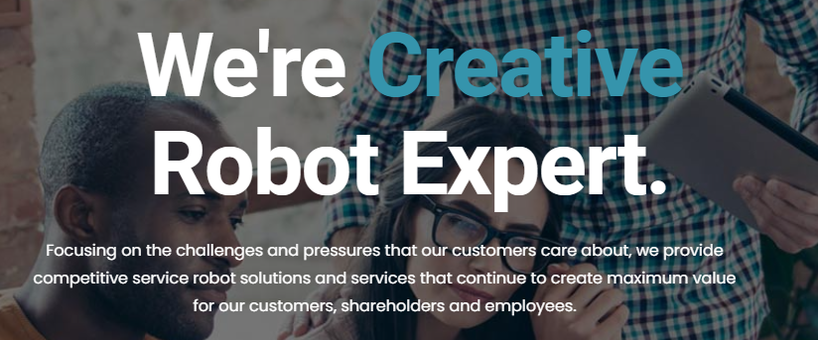
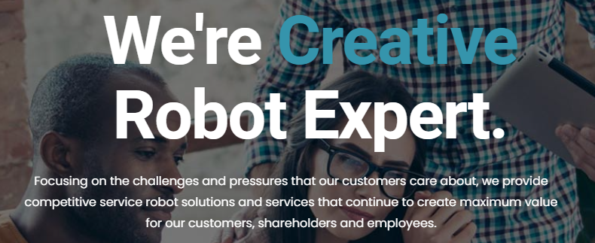
The homepage has a publicity video, which respectively introduces the following big things: the founder engaged in the field of robotics, formally established Guangzhou Aobo Information Technology Co., LTD., the company has obtained the software copyright and appearance design patent, the robot is distributed all over the country, the company launched disinfection robot in response to the epidemic
It also briefly describes the company's mission and services

Slide 2
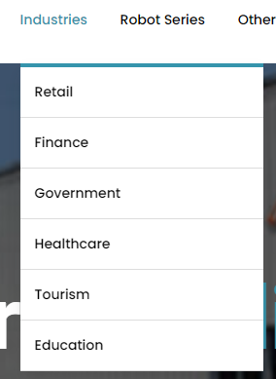
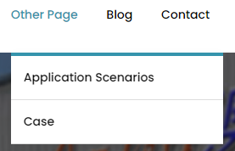
There is a LOGO near the navigation bar, and the navigation bar contains some functions includes Home, Industries, Robot Series, Other Page, Blog and Contact. By the way, The Industries contains Retail, Finance, Government Healthcare Tourism Education and Other Page contains Application Scenarios and Case.

Slide 3
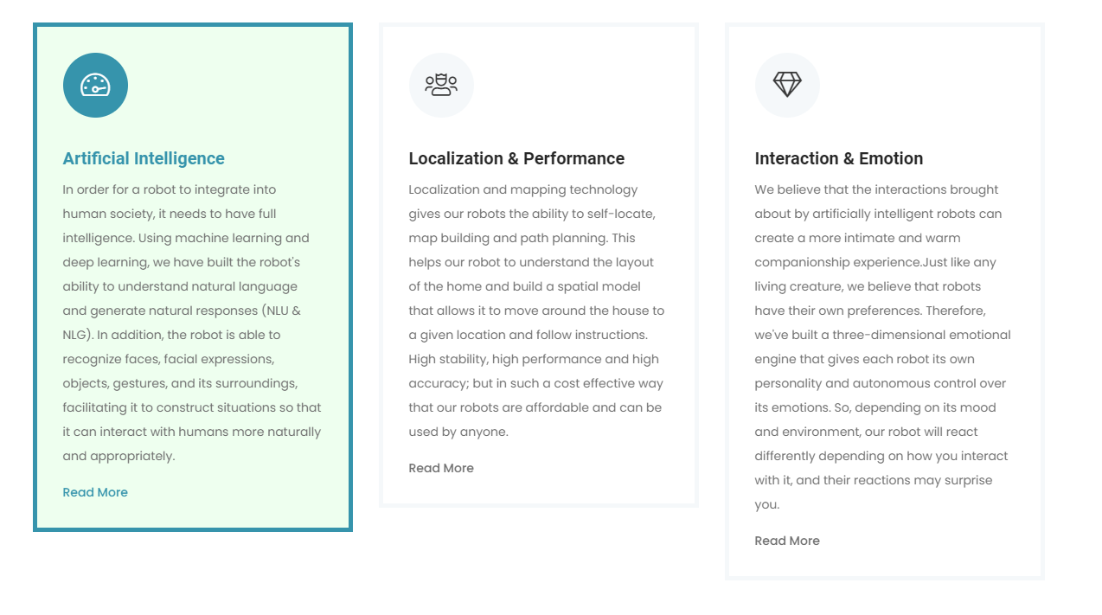
In the About Us plate, the left of it introduces us some information about what abilities artificial intelligence have to integrate into human society,
The middle of the plate introduces Localization and Performance of robots (high stability, high performance and high accuracy),
The right of the plate introduces Interaction and Emotion of robots. They believe that robots can have their emotion.

Slide 4
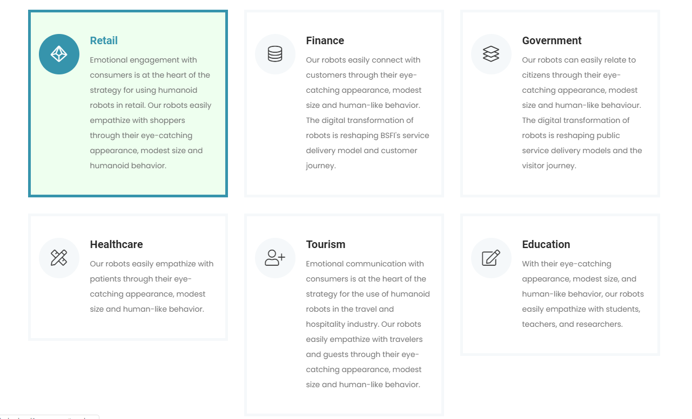
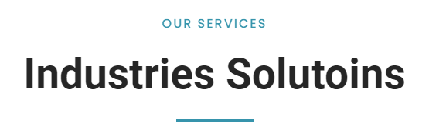
The next page displays Industries Solutions
This page mainly shows about two things:
One is shows emotional engagement with consumers is at the heart of the strategy for using humanoid robots in retail.
And the other tells us robots can easily connect with customers through eye-catching appearance.

Slide 5
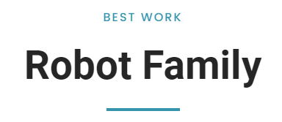
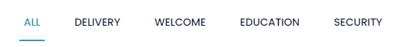
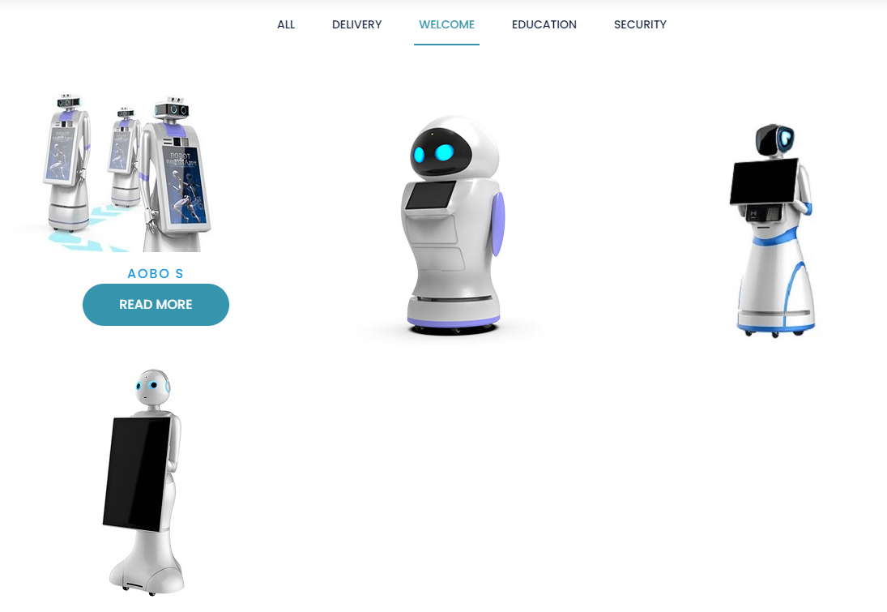
Then the next plate displays many kinds of robots for us. We can not only see the types of robots, but also can screen out what we want.
This navigation bar can let us do whatever type robots picking we want.
For example, if we choose the WELCOME robots, the page will automatically help us pick all the welcome robots for us. So we can pick robots we need conveniently.

Slide 6
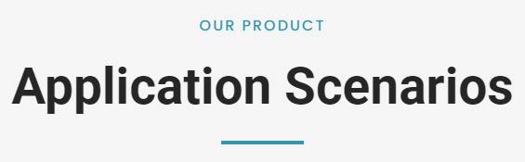
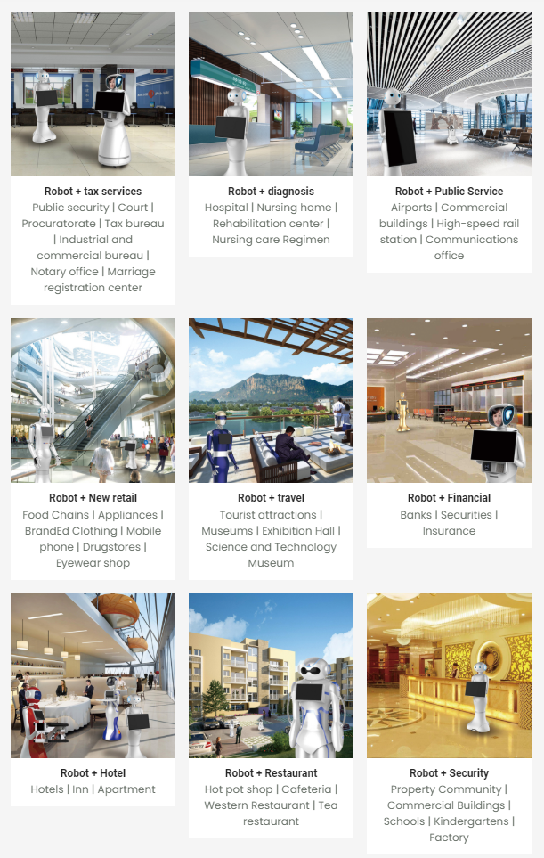
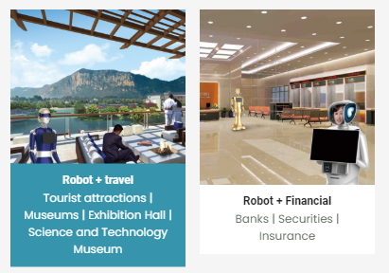
This plate describes where the Aobo robots can apply. And there are nine pictures of representative application scenarios below.
If we put the mouse over it, we will find that the picture is highlighted, which will make it clearer and more accurate for us to watch.

Slide 7
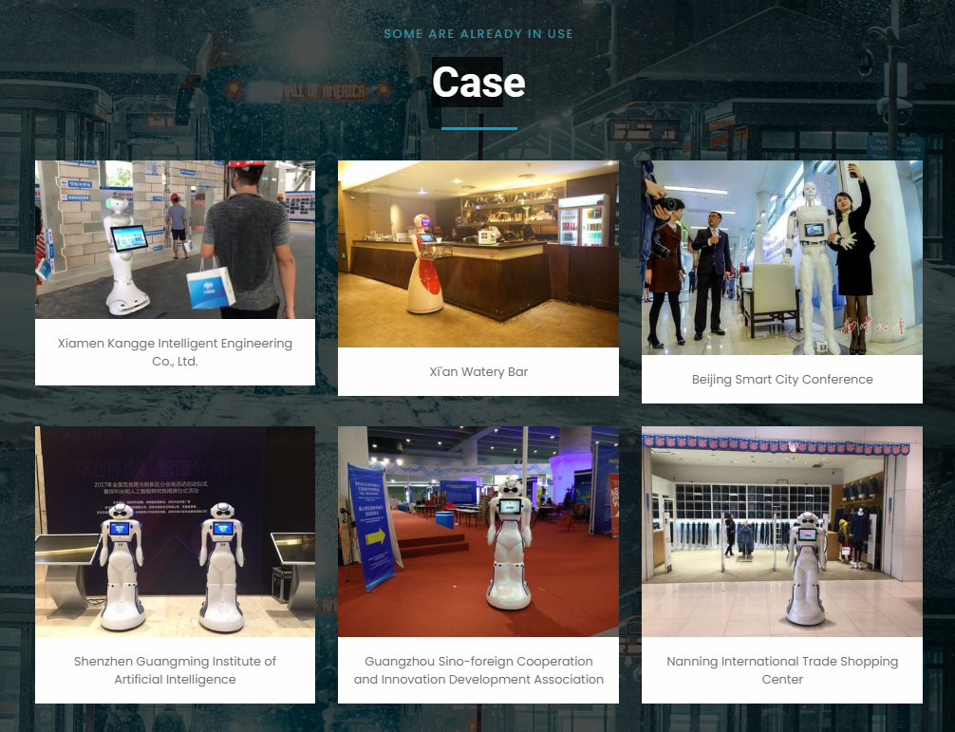
This page and the last page are both belong to Other Page function, which is on the navigation bar. They are two branches of it.
On this page we can see the robots appeared at many big cities in China include Xiamen, Xi’an, Beijing, Shenzhen, Guangzhou and Nanjing and so on.
And also, If we put the mouse over it, picture will be highlighted.

Slide 8
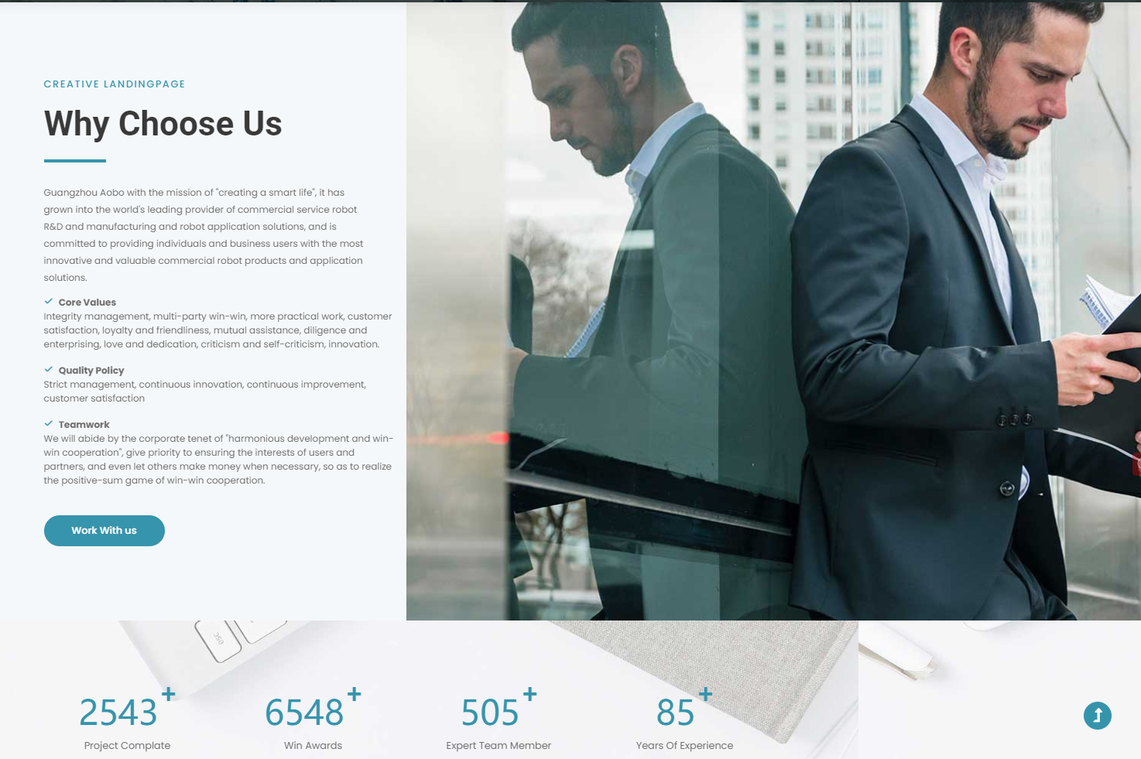
This page introduces some of reasons about why the users would rather choose Aobo robots. There are an overview and three specific reasons(Core Values, Quality Policy and Teamwork).

Slide 9
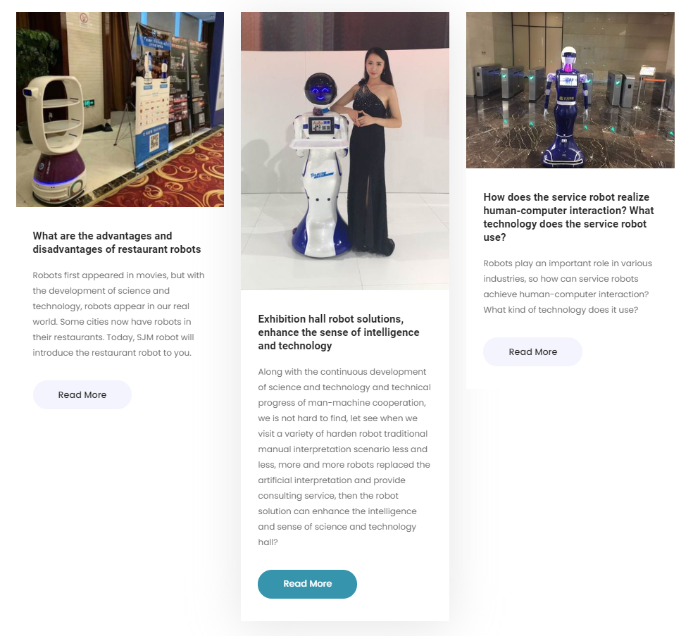
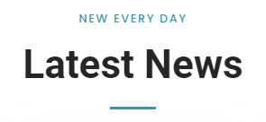
This page shows three latest news about the company:
The first is what are the advantages and disadvantages of restaurant robots.
The second is exhibition hall robot solutions, enhance the sense of intelligence and technology.
The third is how does the service robot realize human-computer interaction and what technology does the service robot use.
We can read more information by clicking it.

Slide 10
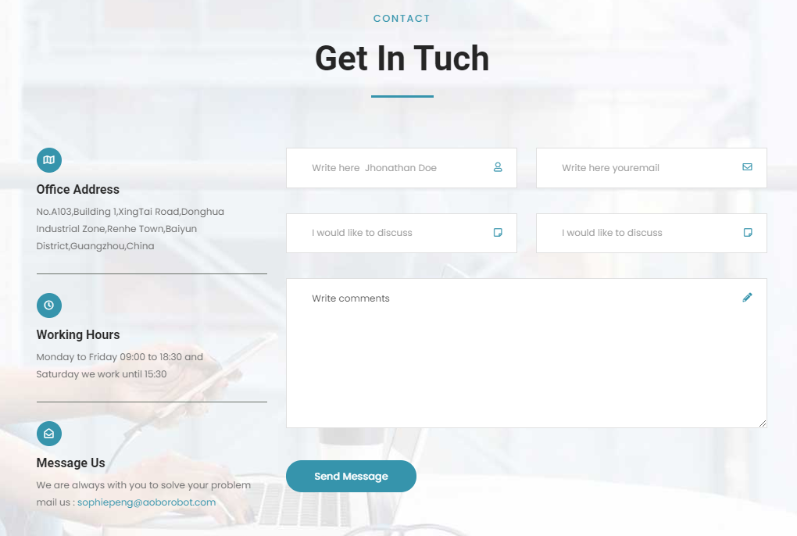
The end of the web provides us a table , which we can write our basic information on it to contact with the company.
Also, there are some information about the company:
office address(No.A103,Building 1,XingTai Road,Donghua Industrial Zone,Renhe Town,Baiyun District,Guangzhou,China),
Working Hours
(Monday to Friday 09:00 to 18:30 and
Saturday we work until 15:30)
and company’s email.

